Slide 1
Experiment Design
Data science practice
April 25, 2022

Slide 2
Today’s topic:
Random Sampling
Stratified Random Sampling
Cross Validation

Slide 3
Data Science Flow
Let`s start!
1
Data Collection
CGIs, Sampling Automation
Data Preprocessing
2
Median Filter, Data cleansing
3
Feature Extraction
EM, GMM, HHT, PCA, LDA, etc.
Transformation
4
Histogram, KLD, EMD, K-Means, Kernel Mapping
5
Modelling
T-Test, Chi-Square, Wilcoxon Signed Rank Test
Experiment Design
6
Random Sampling, Cross Validation
Result
FAR, FRR, EER, etc.

Slide 4
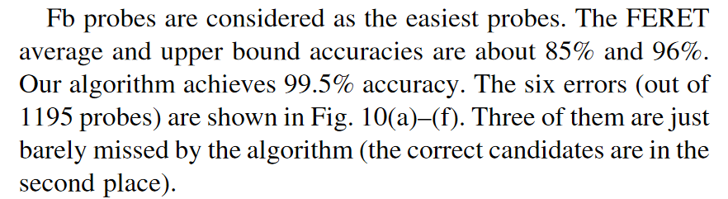
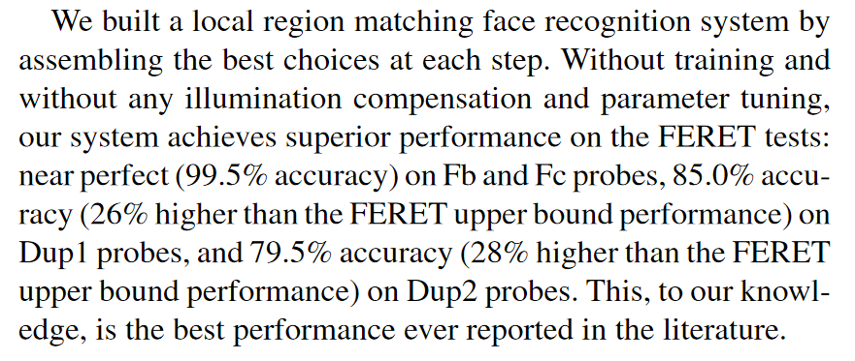
Experiment Result: Academic Paper
How we determine accuracy of our system?
How we claimed that we are the best?
Source: https://doi.org/10.1109/TIP.2007.904421

Slide 5
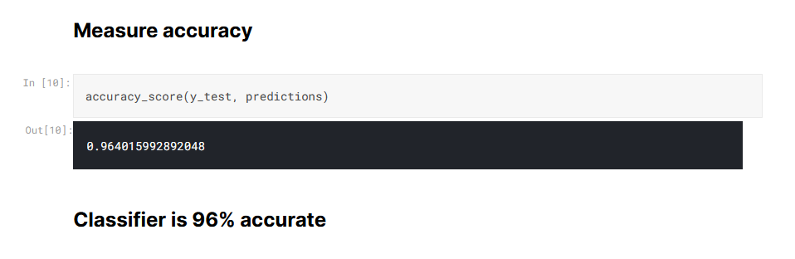
Experiment Result: Kaggle Competition
How we determine accuracy of our system?
Does our claim will make us win the competition?
Source: https://www.kaggle.com/lindleylawrence/company-bankruptcy-prediction-classification

Slide 6
Data Collection
Data Preprocessing
Feature Extraction and Transformation
Training
Correct Result comes from Correct Experiment
Testing
The need of correct experiment design
Result

Slide 7
Experiment Design
How we allocate data for training and testing?
How many rounds of experiments needed? (1 round is not enough)
In n rounds experiment, how we allocate data for each round?
Do we need cross validation?

Slide 8

Example of bad experiment design
Use the same data for training and testing, get 99% accuracy
Imagine your final exam test question is the SAME with example question in daily classes
Your teacher will not do that.

Slide 9
Random Sampling

Slide 10
Random Sampling: Motivation
We have a lot of data (thousands / millions / billions)
How we make an analysis?
How we build a model?
Do we make an analysis / build a model based on the whole data
Millions of data
Notes:
cost ratio of 3 indicates that type-1 error is considered to be 3 times more costly
than type-2 error

Slide 11
Random Sampling: Motivation
How we make an analysis?
Millions of data
Analyze only part of the data set?
Analyze All?

Slide 12
Random Sampling: Motivation
How we make a model?
Millions of data
Train Data
Test Data
Train Data
Test Data

Slide 13
Random Sampling: Motivation
Pick small group of sample will speed up experiment time.
How to select small group of sample?
What if our data consists of several categories. We can’t just select “randomly” from all categories

Slide 14
Random Sampling
Case: smartphone authentication TEAM

Slide 15


Data in Smartphone Authentication Team:
Collected in Two Posture: Sit and Stand
Stand posture
Sit posture

Slide 16



Data in Smartphone Authentication Team:
Mimic various kinds of application
Reading newspaper, tends to swipe short and slowly
Social media,
tends to swipe in moderate pace
Looking for photos,
swipe long and fast

Slide 17
Our Dataset
Short
Sit
Medium
Long
Dataset
Short
Stand
Medium
Long

Slide 18
Flick Statistics with 5 flicks per histogram
Flick Category | Least histogram per user | Most histogram per user
Sit short | 198 | 981
Sit medium | 558 | 1679
Sit long | 460 | 2375
Stand short | 212 | 989
Stand medium | 539 | 1672
Stand long | 426 | 2367
Insufficient samples
too many samples

Slide 19
Imbalanced Data (Bankruptcy Prediction Case)
 | Count
Normal Company | 10,000
Bankrupt Company | 100

Slide 20
How we build “ready-to-use” dataset?
Sit Short
Train Data
Sit Medium
Sit Long
?
Stand Short
Test Data
Stand Medium
Stand Long

Slide 21
How we build “ready-to-use” dataset?
Sit Short
Sit Medium
Train
Train
Train
Sit Long
?
…
Stand Short
Test
Test
Test
Stand Medium
Round 1 set
Round 2 set
Round n set
Stand Long

Slide 22
Simple Random Sampling: Keep the data distribution of each category
Original Data Distribution of user #2
Flick Category | User’s histogram
Sit short | 200
Sit medium | 300
Sit long | 400
Stand short | 200
Stand medium | 300
Stand long | 400
Split the data for 5 round experiment !
Round 1
Round 2
Round 3
Round 4
Round 5
Train
Test
In total, we need 10 sets of data

Slide 23
Simple Random Sampling: Keep the data distribution of each category
Original Data Distribution of user #2
Data Distribution of each set for user #2
Flick Category | User’s histogram
Sit short | 200
Sit medium | 300
Sit long | 400
Stand short | 200
Stand medium | 300
Stand long | 400
Flick Category | User’s histogram
Sit short | 20
Sit medium | 30
Sit long | 40
Stand short | 20
Stand medium | 30
Stand long | 40

Slide 24
Some of our approach (1): Internal random permutation before sampling
Example:
We have 10 histogram, need 3 histogram per round, for 3 rounds
Histogram 1
Histogram 5
Round 1
Histogram 5
Histogram 2
Histogram 8
Histogram 8
Histogram 3
Histogram 10
Histogram 10
Histogram 4
Histogram 1
Round 2
Histogram 1
Histogram 5
Random permutation
Histogram 7
Split the data for several rounds
Histogram 7
Histogram 6
Histogram 9
Histogram 9
Histogram 7
Histogram 6
Round 3
Histogram 6
Histogram 8
Histogram 2
Histogram 2
Histogram 9
Histogram 3
Histogram 3
Histogram 10
Histogram 4
The samples for every round must be different

Slide 25
Some of our approach (2): Use a data several times
Round 1
Round 2
Round 3
Round 4
Round 5
Histogram 5
Histogram 1
Histogram 2
Histogram 5
Histogram 8
Histogram 8
Histogram 2
Histogram 8
Histogram 4
Histogram 6
Histogram 10
Histogram 9
Histogram 3
Histogram 9
Histogram 10
Histogram 1
Histogram 5
Histogram 10
Histogram 1
Histogram 9
Histogram 7
Histogram 7
Histogram 6
Histogram 3
Histogram 2
The samples combination for every round must be different
Histogram 7 appears in both Round 1 and Round 2. Is it okay?

Slide 26
Some of our approach (2): Use a data several times
Example:
We have 10 histograms, need 5 histograms per round, for 5 rounds
Histogram 1
Histogram 2
Histogram 3
Histogram 4
Histogram 5
Histogram 6
Histogram 7
Histogram 8
Histogram 9
Histogram 10

Slide 27
Some of our approach (2): Use a data several times
Example:
We have 10 histograms, need 5 histograms per round, for 5 rounds
Histogram 1
Histogram 5
Histogram 5
Histogram 2
Histogram 8
Histogram 8
Histogram 3
Histogram 10
Histogram 10
Histogram 4
Histogram 1
Histogram 1
Histogram 5
Random permutation
Histogram 7
Pick first 5 data
Histogram 7
Histogram 6
Histogram 9
Data for round 1
Histogram 7
Histogram 6
Histogram 8
Histogram 2
Histogram 9
Histogram 3
Histogram 10
Histogram 4

Slide 28
Some of our approach (2): Use a data several times
Example:
We have 10 histograms, need 5 histograms per round, for 5 rounds
Histogram 5
Histogram 1
Histogram 1
Histogram 8
Histogram 2
Histogram 2
Histogram 10
Histogram 9
Histogram 9
Histogram 1
Histogram 5
Histogram 5
Histogram 7
Repeat random permutation
Histogram 7
Repeat Pick first 5 data
Histogram 7
Histogram 9
Histogram 4
Data for round 2
Histogram 6
Histogram 6
Histogram 2
Histogram 8
Histogram 3
Histogram 3
Histogram 4
Histogram 10

Slide 29
Some of our approach (3): N-Fold Cross Validation
Later in the last session..

Slide 30
Problem in Random Sampling
Case: bankruptcy prediction

Slide 31
Random Sampling in Imbalanced Data set (Bankruptcy Prediction)
 | Number of Company
Normal Company (+) | 10,000
Bankrupt Company (-) | 100
Split the data for 5 round experiment !
Round 1
Round 2
Round 3
Round 4
Round 5
Train
Test
In total, we need 10 sets of data

Slide 32
Random Sampling in Imbalanced Data set (FDP Case)
 | Number of Company
Normal Company (+) | 10,000
Bankrupt Company (-) | 100
 | Number of Company
Normal Company (+) | 1000
Bankrupt Company (-) | 10
Data for each class is imbalance,
Imbalance data will reduce classifier’s performance

Slide 33
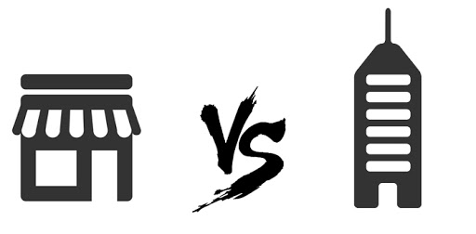
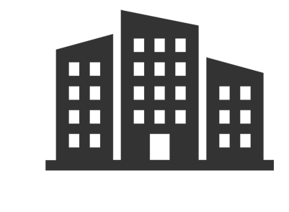
Random Sampling in Imbalanced Data set (Bankruptcy Prediction Case)
Asset: $10,000
 | Number of Company
Normal Company (+) | 10,000
Bankrupt Company (-) | 100
Asset: $1,000,000
Asset: $100,000,000
No small size company in bankrupt dataset

Slide 34
Random Sampling in Imbalanced Data set (FDP Case)
How to create balanced dataset for financial distress prediction?
Each sample set must contain company from all categories (small, medium, high)

